Slide 2
Mental pain is less dramatic than physical pain, but it is more common and also more hard to bear. The frequent attempt to conceal mental pain increases the burden: it is easier to say “My tooth is aching” than to say “My heart is broken.”
C.S. Lewis

Slide 3
Beloved, I pray that you may prosper in all things and be in health, just as your soul prospers.
3 John 1:2 NKJV

Slide 4
Notes:
Running for my own shadow story

Slide 6
MENTAL WELLNESS
TIME

Slide 7
SHADOWS OF LIFE
MENTAL WELLNESS
TIME

Slide 8
SHADOWS OF LIFE
MENTAL WELLNESS
TIME

Slide 9
SHADOWS OF LIFE
MENTAL WELLNESS
TIME

Slide 10
BETTER THAN
AVERAGE EFFECT

Slide 11
WHO REPORT (2001) : Mental Disorders affect 1 in 4 people world wide
NIMH (2020): Mental illnesses are common in the USA. Nearly 1 in 5 US adults live with a mental illness
Notes:
In the USA Mental Health is lower for women – maybe are more in touch with their mental health
BUT VERY CONCERNING – the age group most affected in the USA is Young Adults 18-25 years

Slide 12
WE
ARE
multifaceted
BEINGS

Slide 13
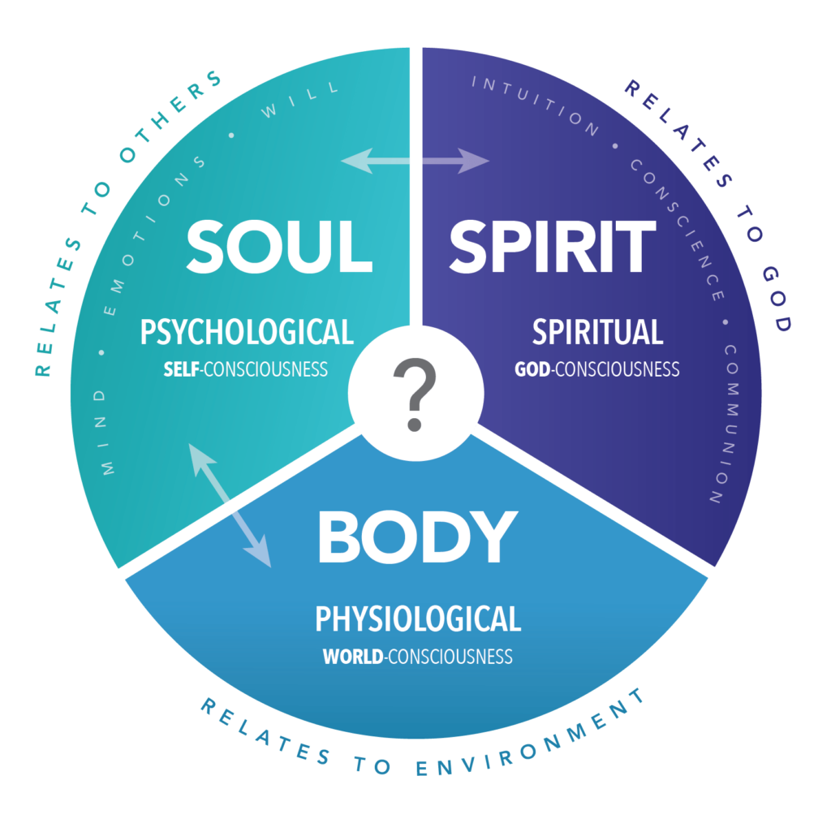
May your whole spirit, soul and body be kept blameless at the coming of our Lord Jesus Christ.
1 Thes 5:23 NIV

Slide 14
When I kept silent, my bones wasted away through my groaning all day long.
Psa 32:3 NIV

Slide 15
MENTAL
HEALTH
IS A
MULTIDIScIPLINARY
PROCESS

Slide 16
For lack of guidance a nation falls, but victory is won through many advisers.
Prov 11:14 NIV

Slide 17
FIND
A
GOOD
BOOK

Slide 18
JESUS
PAID
THE
FULL PRICE

Slide 19
But he was pierced for our transgressions, he was crushed for our iniquities; the punishment that brought us peace was on him, and by his wounds we are healed.
Isa 53:5 NIV

Slide 20
ELIJAH

Slide 21
As they were walking along and talking together, suddenly a chariot of fire and horses of fire appeared and separated the two of them, and Elijah went up to heaven in a whirlwind.
2 Kings 2:11 NIV

Slide 22
Enoch walked faithfully with God; then he was no more, because God took him away.
Gen 5:24 NIV

Slide 23
Elijah was afraid and ran for his life. When he came to Beersheba in Judah, he left his servant there, while he himself went a day's journey into the wilderness. He came to a broom bush, sat down under it and prayed that he might die. “I have had enough, LORD,” he said. “Take my life; I am no better than my ancestors.”
1 Kings 19:3-4 NIV

Slide 24
ENOCH HAD IT ALL TOGETHER
MENTAL HEATLTH

Slide 25
ENOCH HAD IT ALL TOGETHER
ELIJAH HAD A BAD MENTAL DAY
MENTAL HEATLTH

Slide 26
ENOCH HAD IT ALL TOGETHER
ELIJAH HAD A BAD MENTAL DAY
BOTH MADE IT
MENTAL HEATLTH

Slide 27
ENOCH HAD IT ALL TOGETHER
ELIJAH HAD A BAD MENTAL DAY
BOTH MADE IT
SO CAN YOU
MENTAL HEATLTH

Slide 28
Then he lay down under the bush and fell asleep. All at once an angel touched him and said, "Get up and eat." He looked around, and there by his head was some bread baked over hot coals, and a jar of water. He ate and drank and then lay down again.
1Kings 19:5-8 NIV

Slide 29
Then he lay down under the bush and fell asleep. All at once an angel touched him and said, "Get up and eat." He looked around, and there by his head was some bread baked over hot coals, and a jar of water. He ate and drank and then lay down again.
1Kings 19:5-8 NIV

Slide 30
Then he lay down under the bush and fell asleep. All at once an angel touched him and said, "Get up and eat." He looked around, and there by his head was some bread baked over hot coals, and a jar of water. He ate and drank and then lay down again.
1Kings 19:5-8 NIV

Slide 31
Then he lay down under the bush and fell asleep. All at once an angel touched him and said, "Get up and eat." He looked around, and there by his head was some bread baked over hot coals, and a jar of water. He ate and drank and then lay down again.
1Kings 19:5-8 NIV

Slide 32
Then he lay down under the bush and fell asleep. All at once an angel touched him and said, "Get up and eat." He looked around, and there by his head was some bread baked over hot coals, and a jar of water. He ate and drank and then lay down again.
1Kings 19:5-8 NIV

Slide 33
The angel of the LORD came back a second time and touched him and said, "Get up and eat, for the journey is too much for you." So he got up and ate and drank. Strengthened by that food, he traveled forty days and forty nights until he reached Horeb, the mountain of God.
1Kings 19:5-8 NIV

Slide 34
The angel of the LORD came back a second time and touched him and said, "Get up and eat, for the journey is too much for you." So he got up and ate and drank. Strengthened by that food, he traveled forty days and forty nights until he reached Horeb, the mountain of God.
1Kings 19:5-8 NIV

Slide 35
The angel of the LORD came back a second time and touched him and said, "Get up and eat, for the journey is too much for you." So he got up and ate and drank. Strengthened by that food, he traveled forty days and forty nights until he reached Horeb, the mountain of God.
1Kings 19:5-8 NIV

Slide 36
The angel of the LORD came back a second time and touched him and said, "Get up and eat, for the journey is too much for you." So he got up and ate and drank. Strengthened by that food, he traveled forty days and forty nights until he reached Horeb, the mountain of God.
1Kings 19:5-8 NIV

Slide 37
The angel of the LORD came back a second time and touched him and said, "Get up and eat, for the journey is too much for you." So he got up and ate and drank. Strengthened by that food, he traveled forty days and forty nights until he reached Horeb, the mountain of God.
1Kings 19:5-8 NIV

Slide 38
STOP

